Slide 1

The Precise Statement
Master Method
Design and Analysis of Algorithms I

Slide 2
The Master Method

Slide 3
Recurrence Format

Slide 4
The Master Method

Slide 5
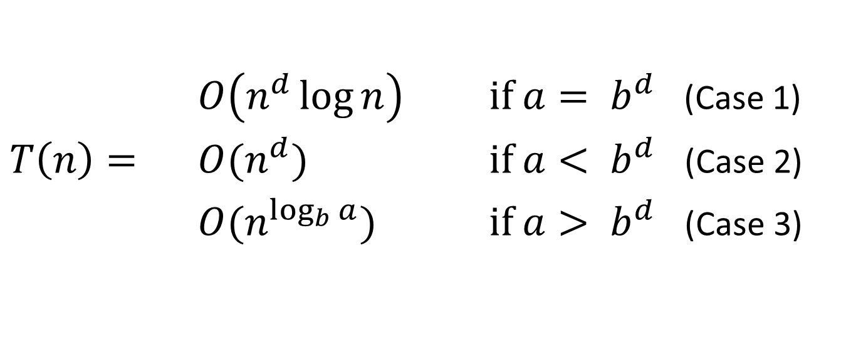
The Master Method
$O\left(n^{d}\log{n}\right)$ if $a= b^{d}$ (Case 1)
$T\left(n\right)=$ $O(n^{d})$ if $a< b^{d}$ (Case 2)
$O(n^{\log_{b}{a}})$ if $a> b^{d}$ (Case 3)

